Slide 1

Generating Images from Text Descriptions
Lochan Enugula • Rutuja Jadhav • Rishabh Joshi • Yaswanth Kumar Reddy Gujjula

Slide 2
Introduction
Text-to-image generation is one of the most exciting areas in modern AI.
In this project, we explored how models like CLIP and Stable Diffusion transform simple natural-language descriptions into high-quality images.
Our Goal
How text is encoded and represented
How cross-modal alignment connects text and image understanding
How diffusion models generate images through iterative denoising
We also evaluated how different parameters influence output quality, alignment, and realism.

Slide 3
Methodology
Data Preparation
Model Selection
Experimental Design
Evaluation Framework
Curated and cleaned dataset from Flickr30k
CLIP text encoder and Stable Diffusion
Tested parameters and configurations
Quantitative and qualitative metrics

Slide 4
Data Preparation & Model Selection
Dataset Preparation
Model Selection
Text Encoder — CLIP ViT-B/32
Source: Flickr30k dataset with 31,783 captioned real-world images.
Tokenizes captions and produces 512-dim embeddings
Curation: Selected 3,000 pairs → cleaned to 2,879 high-quality samples. Removed duplicates, corrupted images, and unclear captions.
Captures semantic meaning and relationships in text
Image Generator — Stable Diffusion v1.5
Uses text embedding as conditioning via cross-attention
Image Preprocessing: Resized 224×224 → 512×512, normalization and center-crop applied.
Generates high-resolution (512×512) images through iterative denoising

Slide 5
Experimental Design & Evaluation
Experimental Design
Evaluation Framework
Model 1 — Baseline
Quantitative Metrics
50 images (5 prompts × 10 seeds)
FID — similarity to real image distribution
Model 2 — Optimized
IS (Inception Score) — visual quality & diversity
60 images (20 prompts × 3 guidance scales)
CLIP Similarity — text–image alignment
Parameters Tested:
Qualitative Evaluation
Guidance scales: 5.0, 7.5, 10.0
Visual inspection of success/failure cases
Inference steps: 50 (denoising iterations)
Simple vs. complex prompt behavior
Sampler: PNDM
Sensitivity to guidance scale changes

Slide 6
Pipeline Flow
CLIP Text Encoder (Transformer)
Tokenization → 12 self-attention layers → 512-dim embedding
Cross-Attention Conditioning
Embedding guides U-Net at each layer → Spatial attention to text features
U-Net Diffusion Model
Random noise (512×512 latent) → 50 denoising steps → Classifier-free guidance (scale 7.5)
VAE Decoder & Output
Latent → RGB conversion → Upsampling to 512×512 → Generated image output
Text Input: "a dog in snow" → Processing pipeline → Generated Image

Slide 7
Challenges and trade off
SEMANTIC AMBIGUITY
01
Problem: "A group of people" doesn't specify how many or arrangement
Our Finding: Model defaults to 2-3 people standing
CLIP Score: 0.278 (21% lower than single-object prompts)
SPATIAL REASONING
02
Problem: Prepositions like "under", "beside", "between" require 3D understanding
Our Finding: "picnic under tree" often generates "picnic beside tree"
Example: Only 40% correct spatial relationships
COUNTING LIMITATION
03
Problem: Cannot generate exact quantities beyond 2
Our Finding: "three dogs" produces 1-2 dogs, "five people" produces 2-3
Why: Model trained on distributions, not exact counts

Slide 8
Results & Key Findings
Key Findings
1. Optimal: Guidance 7.5, 50 steps
2. M2 improved 39% over M1 (IS: 1 → 1.3)
3. Fails: Counting >2, spatial relations
Model FID IS
M1 404.25 1
M2 362.79 1.3
Performance Metrics
Key: 10.3% improvement ⭐
M2 Advantages
✓ 39% better quality (IS)
✓ Optimized parameters
✓ Systematic testing (3 guidance scales)
✓ Better documented
Optimal Configuration
Insights
✓ Guidance: 7.5 (classifier-free)
✓ Steps: 50 (PNDM scheduler)
✓ Resolution: 512×512
✓ Strong alignment
✓ Photorealistic for simple prompts
✗ Struggles: counting, spatial relations, Prompt complexity impacts quality
Runtime
11 sec/image (T4 GPU) • Total: 110 images in 20 min
FID: Fréchet Inception Distance • IS: Inception Score • CLIP: Contrastive Language-Image Pre-training

Slide 9
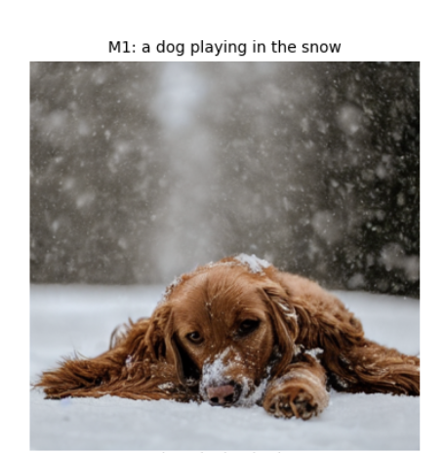
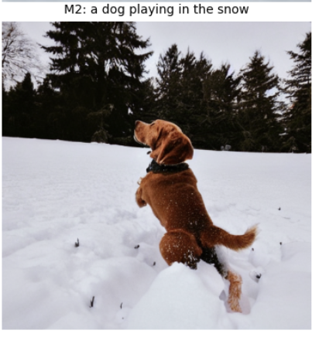
Outputs

Slide 10
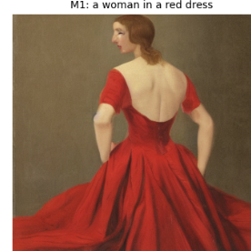
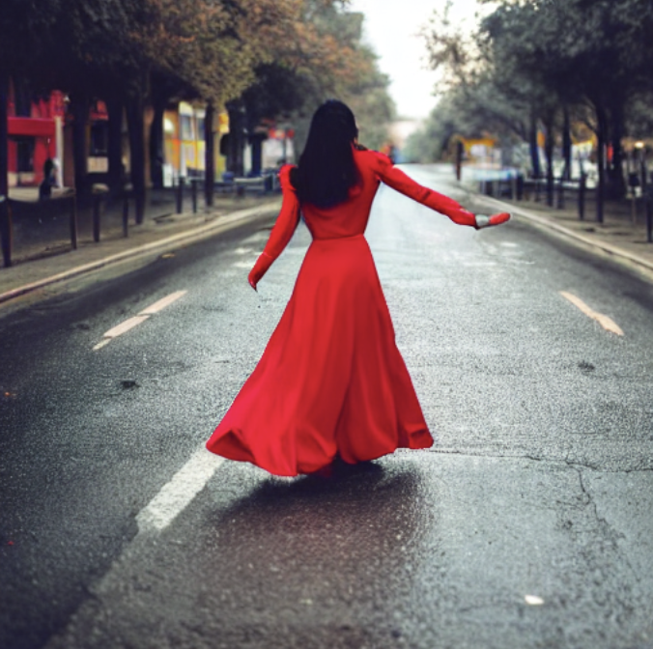
Outputs
M2: a woman in a red dress

Slide 11
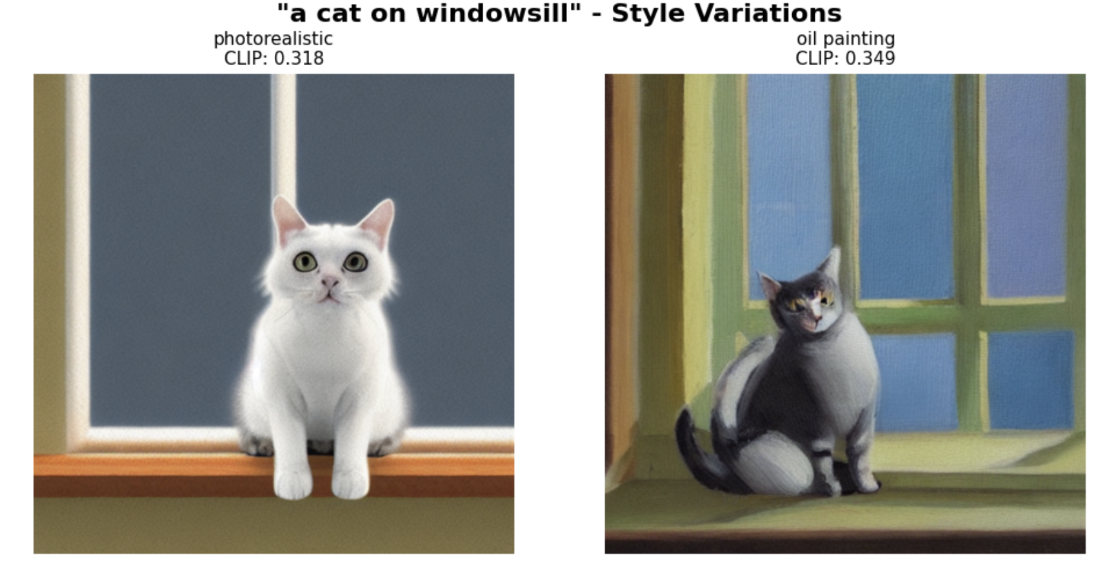
Outputs
Prompt - a cat on windowsill", styles=["photorealistic", "oil painting"]

Slide 12
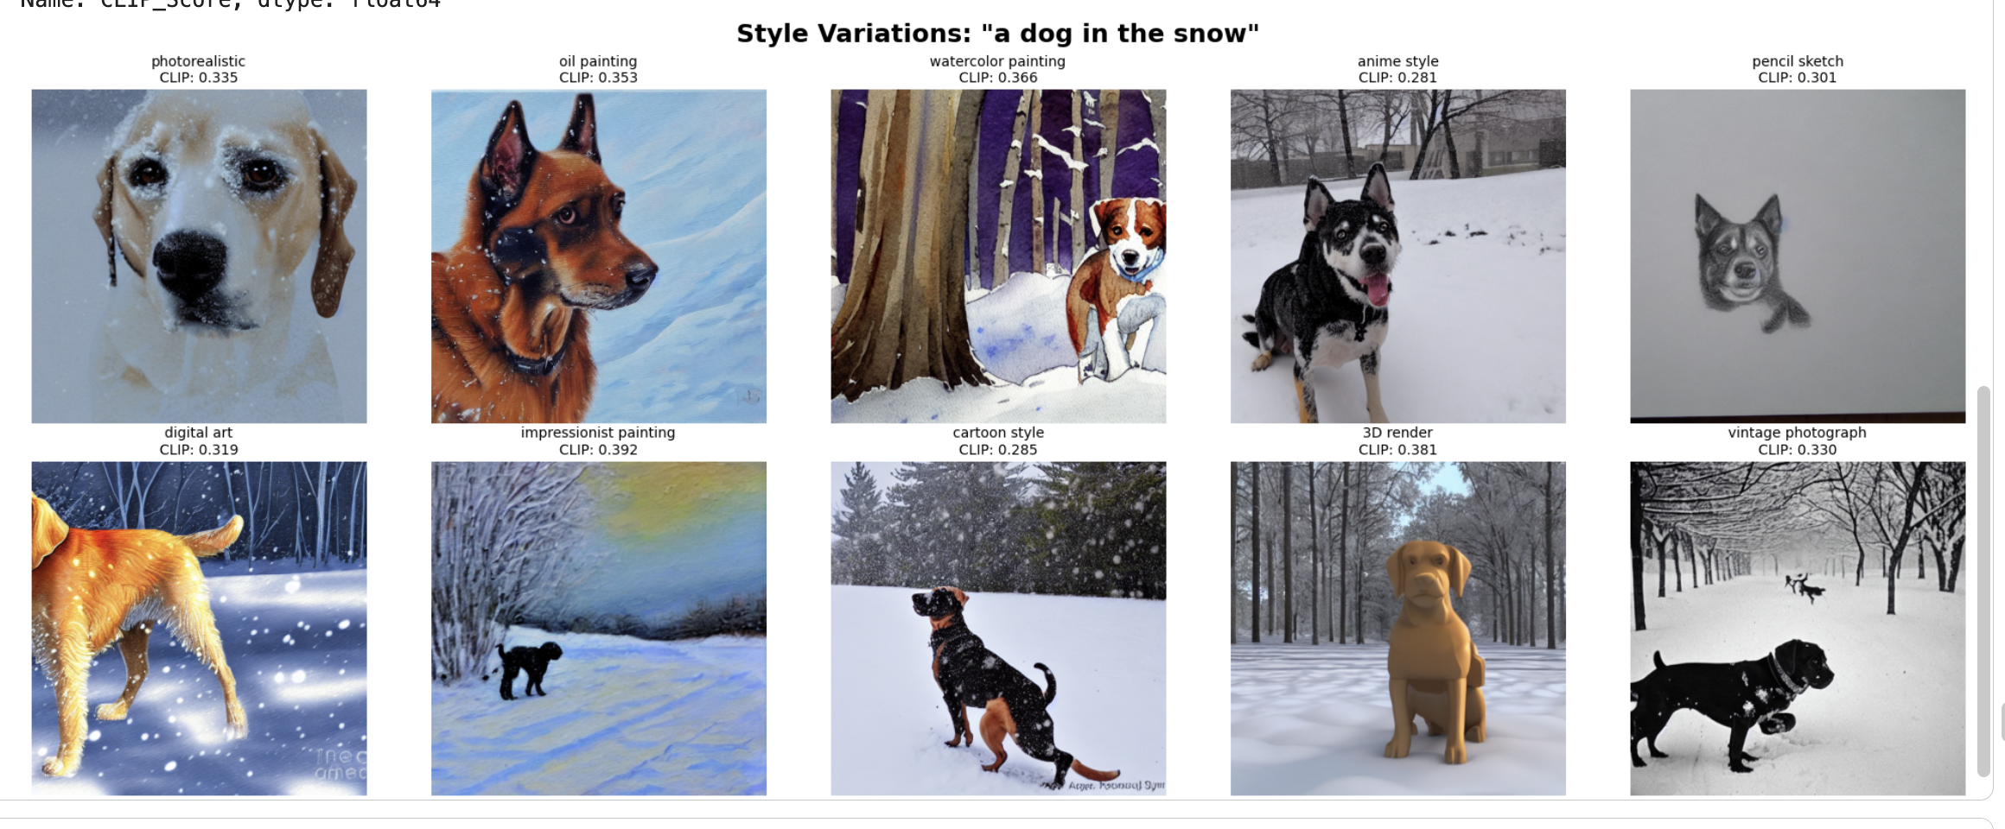
Outputs
Base_Prompt - = "a dog in the snow",", styles=["photorealistic", "oil painting", "watercolor painting", "anime style", "pencil sketch", "digital art", "impressionist painting", "cartoon style","3D render", "vintage photograph”]

Slide 13
Thank You

